Slide 1
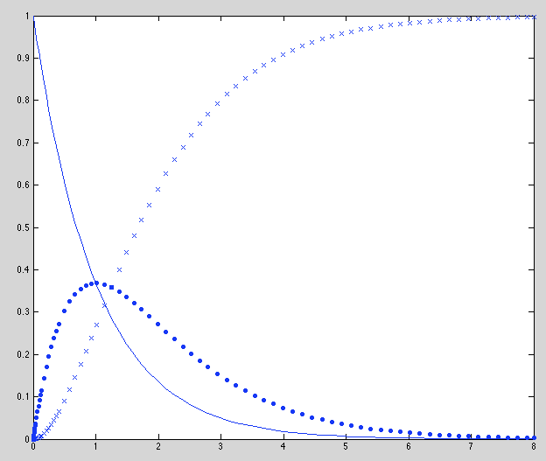
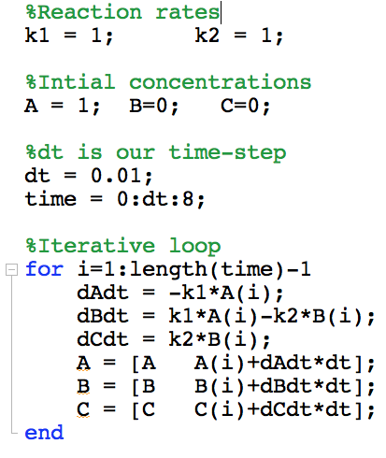
Simple Example: ABC reactor
Importance: This is conceptually what is going on in the more complex software
Substance A becomes B at a rate of k₁ with units of 1/second
k₁
k₂
A
B
C
Substance B becomes C at a rate of k₂ with units of 1/second
The differential equations that describe the change in concentrations can be expressed as:
Here the variables A,B,C represent the concentration of each substance with units of molecules
We can integrate to find a solution using a simple iterative procedure.
A
C
Here we calculate the values from the above equations
Concentration (molecules)
B
Here we add the value of substance at next time-step to the list
Time (seconds)

